Slide 1
StudyNotes – .NET Platform Reunification
Sudhansu Sekhar Sutar

Slide 2
Contents
.NET Framework (Microsoft)
.NET Compact Framework (Microsoft)
Mono Project (Ximian, Inc.)
Xamarin Platform (Xamarin)
.NET Core (Microsoft/OSS)
.Net Portable Class Library
.NET Stack Comparison
.NET Standard Base Class Library
.NET Standard Versions
.NET Reunification Plan
.NET 5 A Unified Platform
.NET Multi-platform App UI (MAUI)
Evolution of .Net Tooling
Microsoft Open Sourced Technology
References

Slide 3
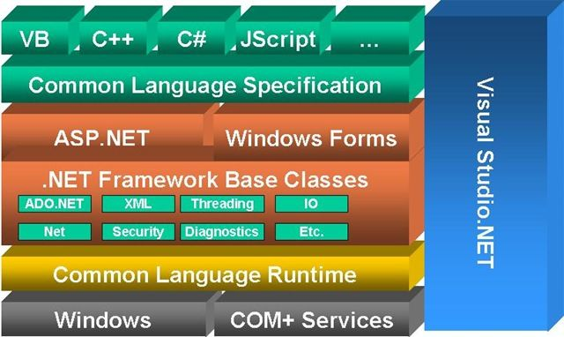
.NET Framework (Microsoft)

Slide 4
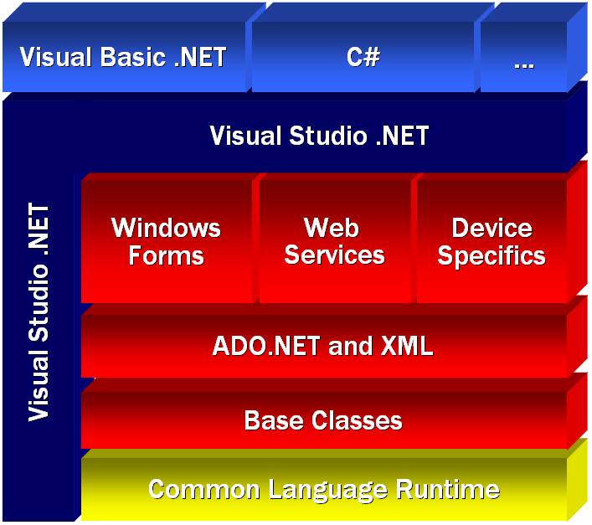
.NET Compact Framework (Microsoft)

Slide 5
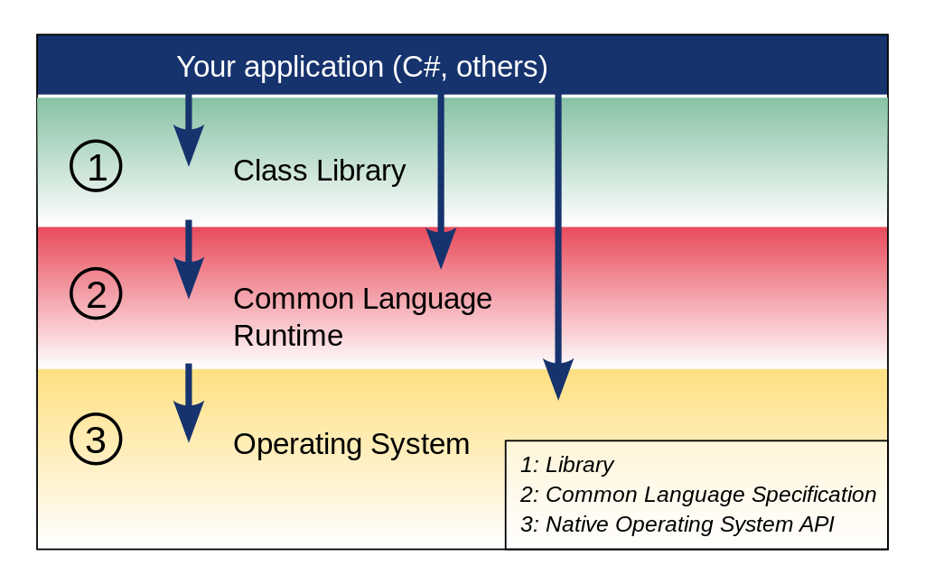
Mono Project (Ximian, Inc.)

Slide 6
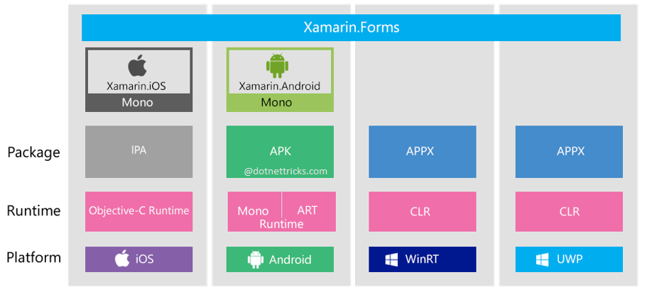
Xamarin Platform (Xamarin)

Slide 7
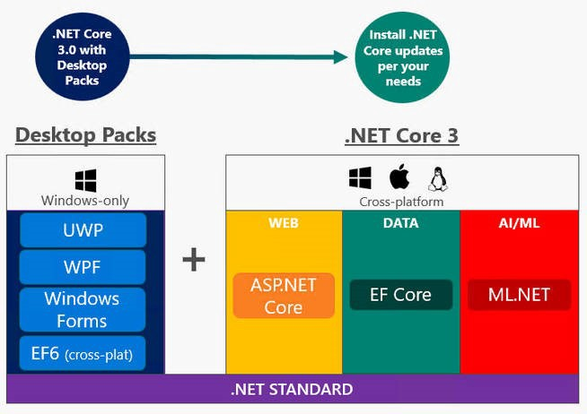
.NET Core (Microsoft/OSS)

Slide 8
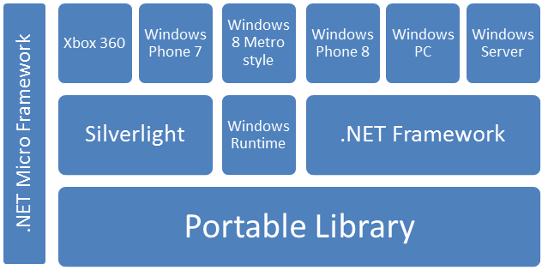
.Net Portable Class Library

Slide 9
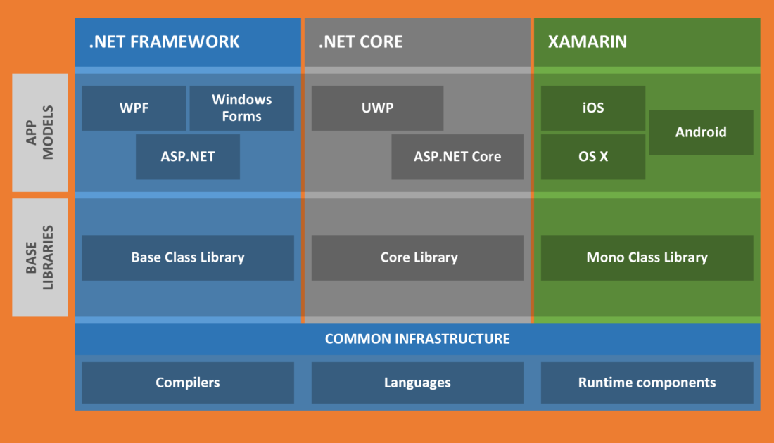
.NET Stack Comparison

Slide 10
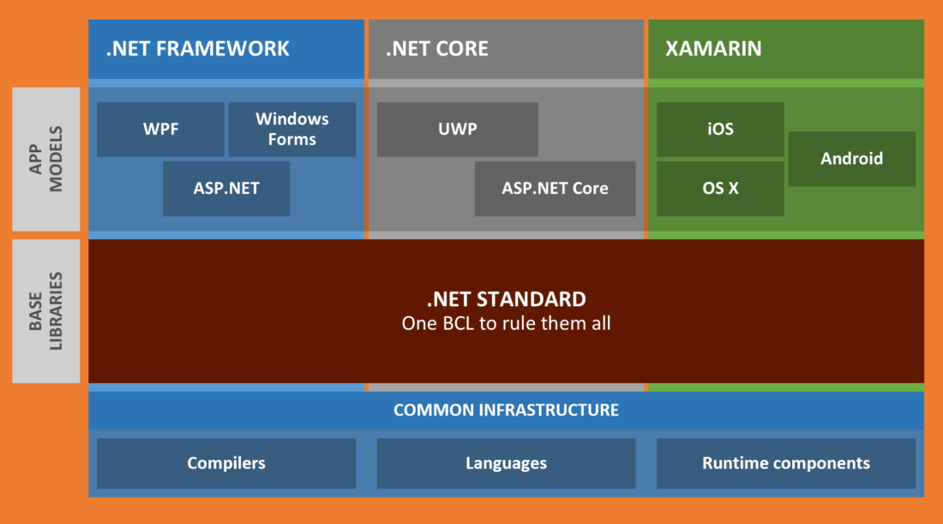
.NET Standard Base Class Library

Slide 11
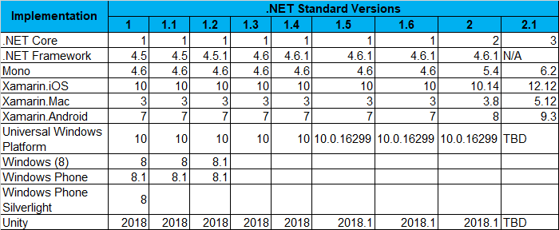
.NET Standard Versions

Slide 12
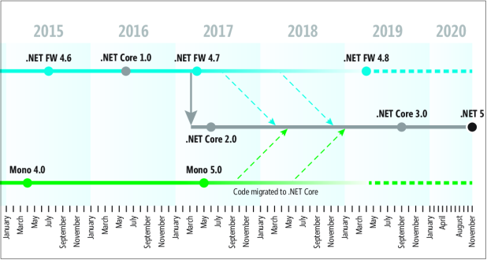
.NET Reunification Plan

Slide 13
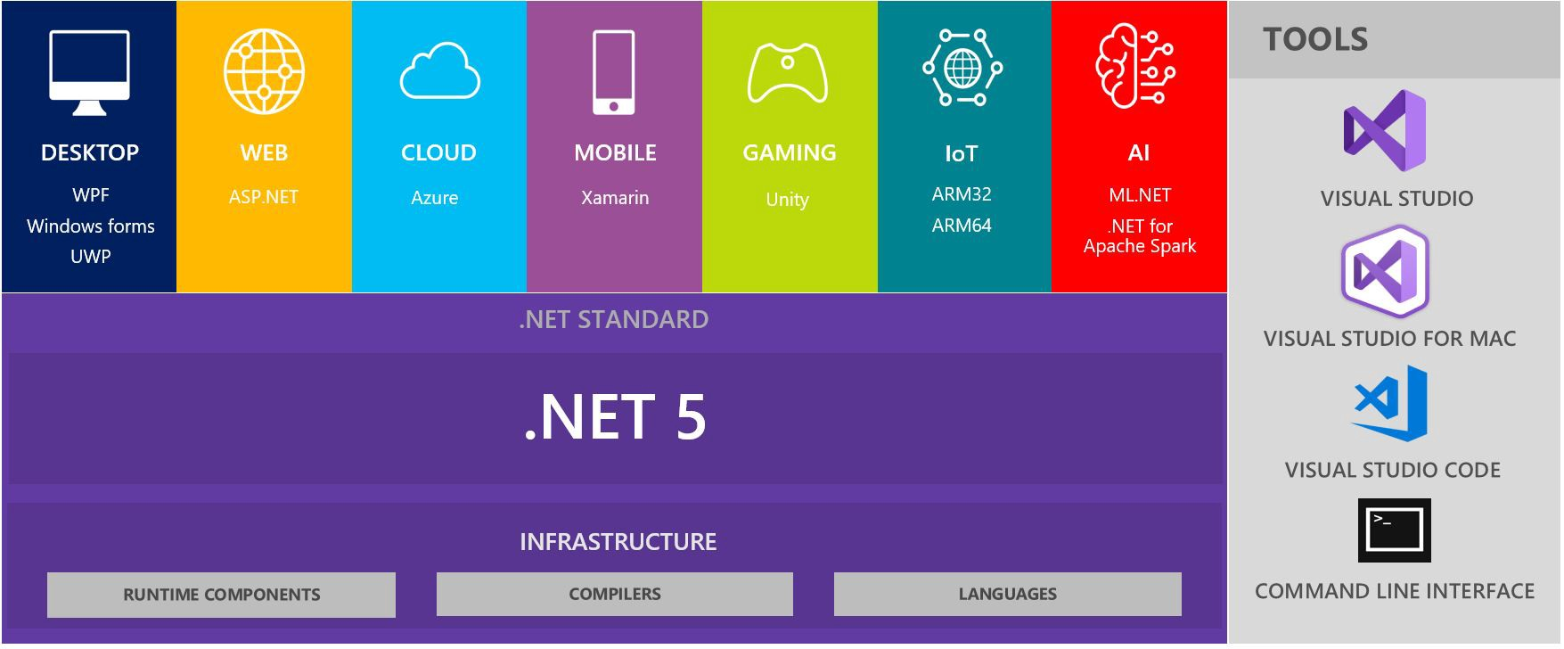
.NET 5 A Unified Platform

Slide 14
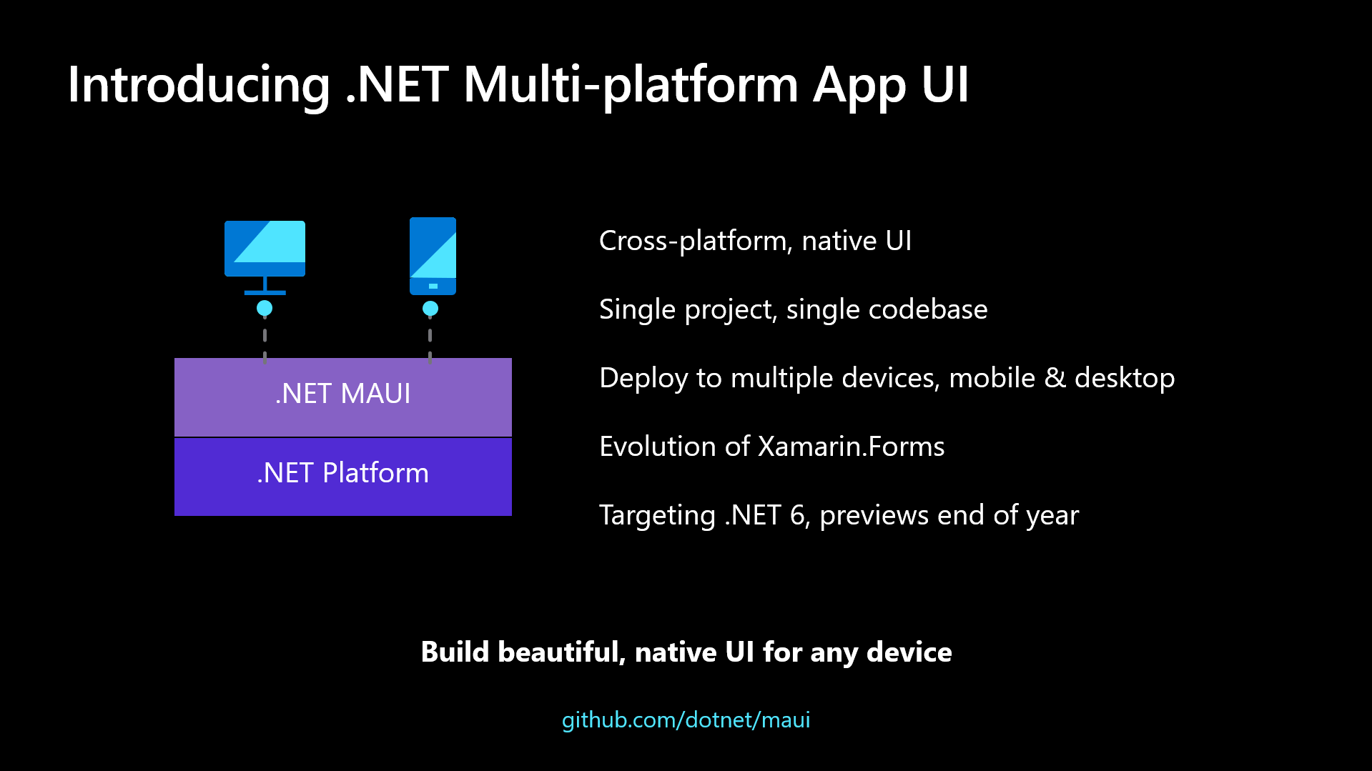
.NET Multi-platform App UI (MAUI)

Slide 15
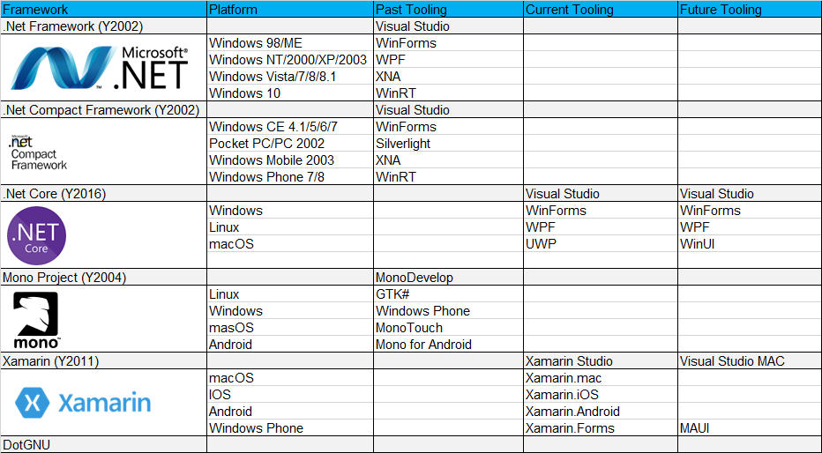
Evolution of .Net Tooling

Slide 16
Microsoft Open Sourced Technology
.Net Core
WinForms
WPF
WinUI
MAUI
ASP.Net Core

Slide 17
References
https://github.com/dotnet/core
https://github.com/dotnet/winforms
https://github.com/dotnet/wpf
https://github.com/dotnet/maui
https://microsoft.github.io/microsoft-ui-xaml/
https://github.com/dotnet/aspnetcore

Slide 18
END OF FILE

